Slide 1
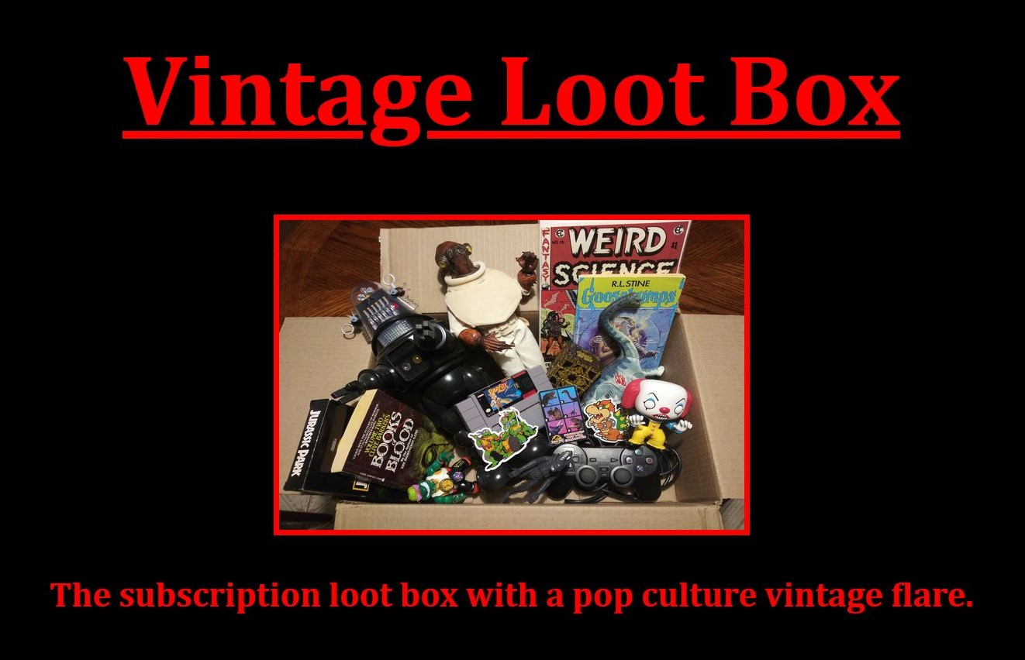
SalesForce And Vintage Loot Box
By: Israel Escobedo
Project 0
01/05/2022

Slide 2

What is Salesforce ?
Cloud based CRM
Multitenant
Hands Free Maintenance & Security
Scalable
SaaS & PaaS
Customization

Slide 3
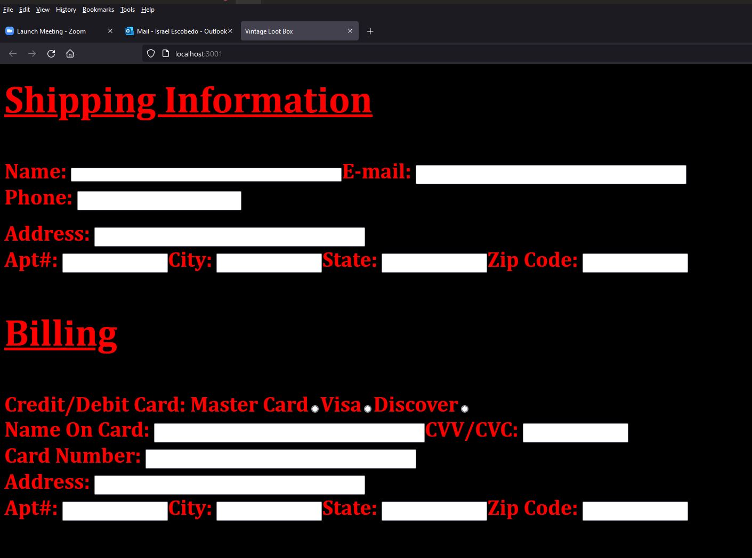
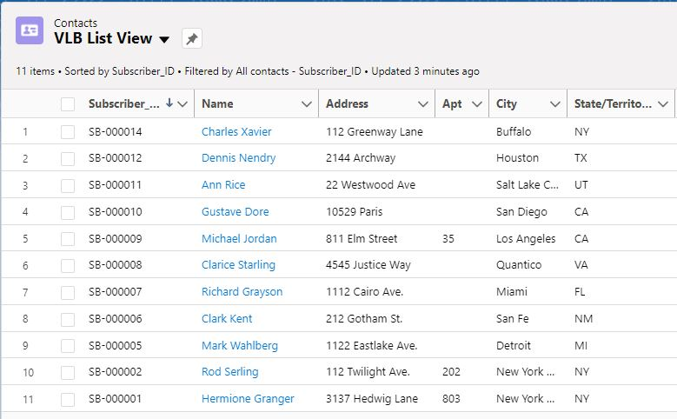
Webpage tO SalesForce

Slide 4
Salesforce features For VLB
Database Management
Database Planning & Implementation
Mass Export & Import
Data Validation
Data Security
Reports & Dashboards
Declarative and Programmatic Customization
Communication Tools
Approval Process
E-mail Alerts
Approval process
User interfaces
List Views
Page Layouts
Lightning Apps

Slide 5
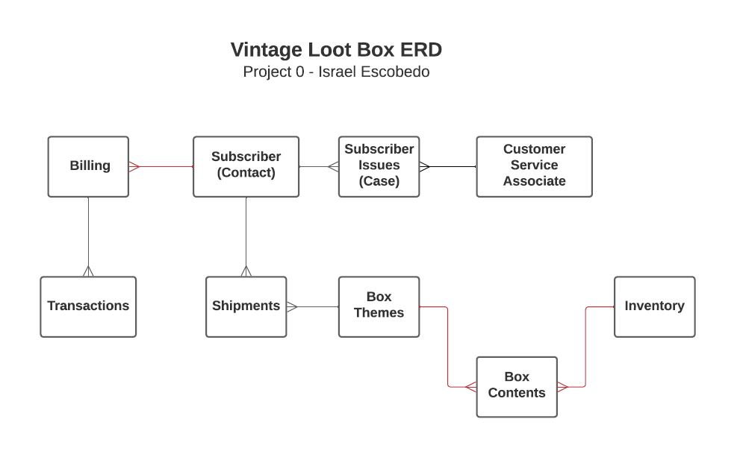
Example: Database Planning

Slide 6
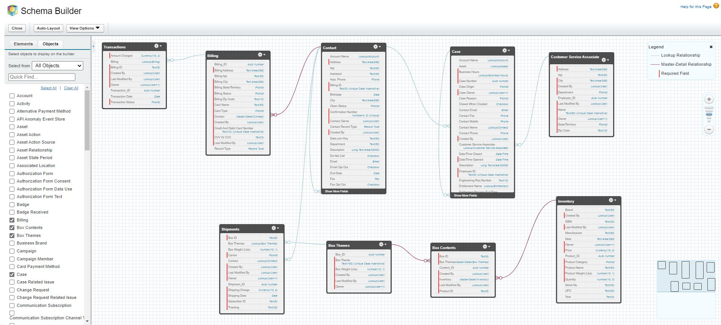
Example: Database Implementation

Slide 7
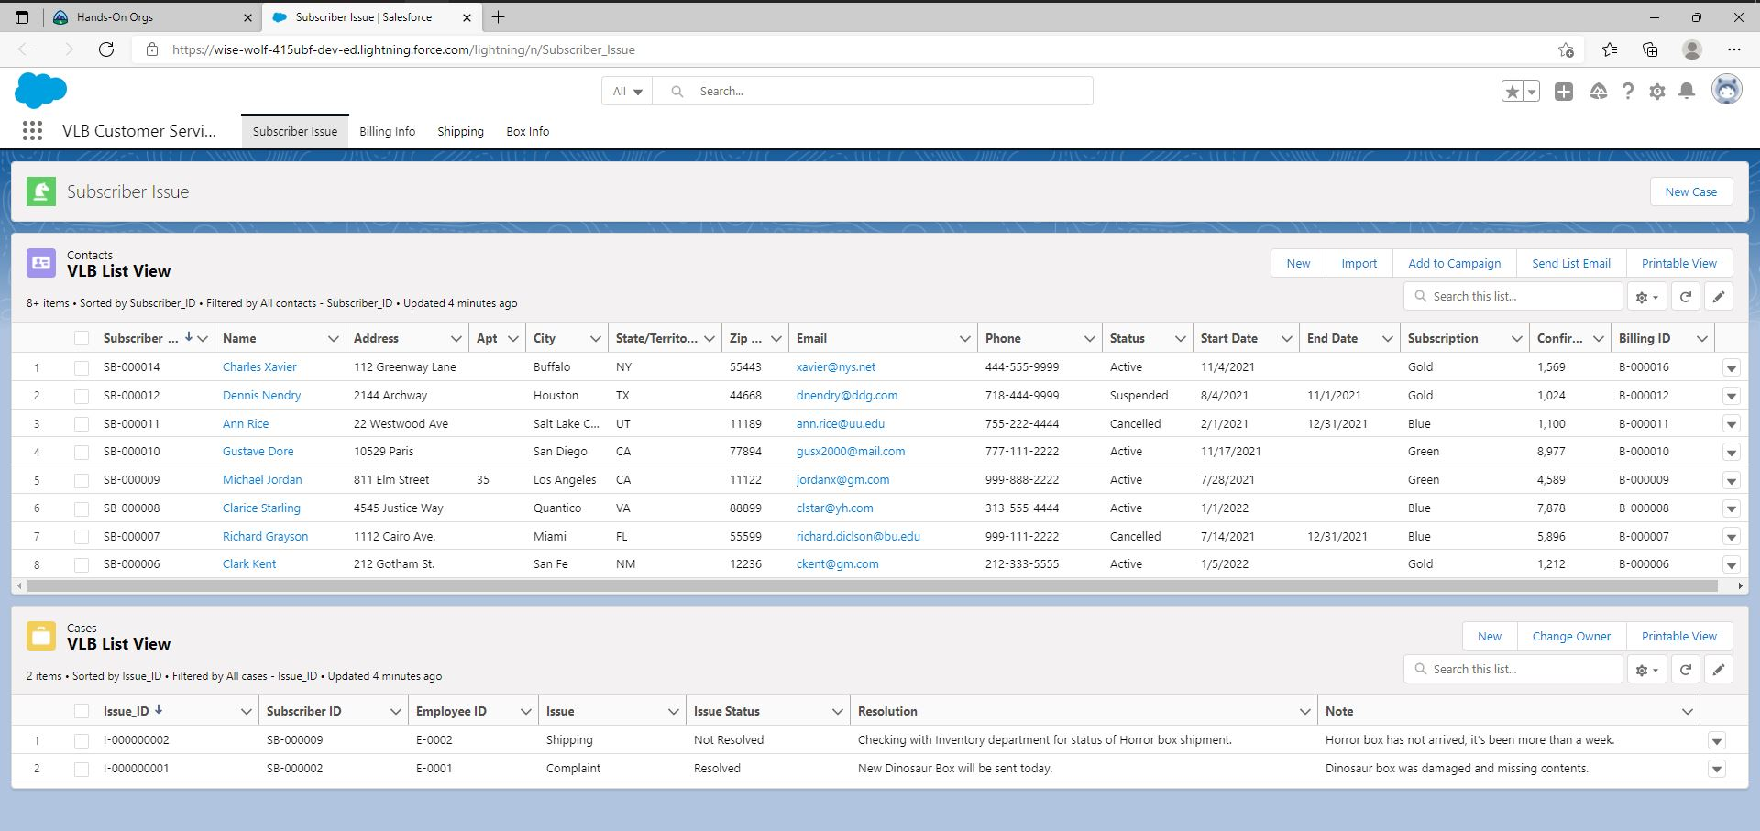
Example: Lightning Application
Custom List Views
Custom Page Layouts
Multiple page app
Data entry & editing tools
Built in validation & processes.

Slide 8
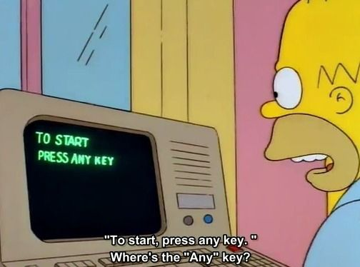
Demo

